Slide 1
Modules in Nodejs
Anju munoth

Slide 2
What is a Module
A module encapsulates related code into a single unit of code.
When creating a module, this can be interpreted as moving all related functions into a file
Module in Node.js is a simple or complex functionality organized in single or multiple JavaScript files which can be reused throughout the Node.js application.
Each module in Node.js has its own context, so it cannot interfere with other modules or pollute global scope.
Also, each module can be placed in a separate .js file under a separate folder.
Node.js implements CommonJS modules standard. CommonJS is a group of volunteers who define JavaScript standards for web server, desktop, and console application.

Slide 3
Node.js Module Types
Node.js includes three types of modules:
Core Modules
Local Modules
Third Party Modules

Slide 4
Node.js Core Modules
Node.js is a light weight framework.
Core modules include bare minimum functionalities of Node.js.
Core modules are compiled into its binary distribution and load automatically when Node.js process starts.
However, need to import the core module first in order to use it in your application.
There is no need to install or download core modules.
To include them in your application, all you need is to use the following syntax:
const http = require('http') //replace `http` with the core module you want to use

Slide 5
Node.js Core Modules
Core modules come with Node.js and don't need to be installed.
Core modules provide low-level functionality and helper methods.
Allow Node.js to work with the filesystem, networking, binary data, streams, spawn external processes, parse query strings, file paths and URLs, and perform other helpful tasks such as creating HTTP(S) agents/clients and servers.

Slide 6
List of main core modules:
fs: module to work with the file system, files and folders
path: module to parse file system paths across platforms
querystring: module to parse query string data
net: module to work with networking for various protocols
stream: module to work with data streams
events: module to implement event emitters (Node observer pattern)
child_process: module to spawn external processes
os: module to access OS-level information including platform, number of CPUs, memory, uptime, etc.
url: module to parse URLs
http: module to make requests (client) and accept requests (server)
https: module to do the same as http only for HTTPS
util: various utilities including promosify which turns any standard Node core method into a promise-base API
assert: module to perform assertion based testing
crypto: module to encrypt and hash information

Slide 7
Node.js Local Module
Local modules are modules created locally in your Node.js application.
These modules include different functionalities of your application in separate files and folders.
Can also package it and distribute it via NPM, so that Node.js community can use it.
For example, if you need to connect to MongoDB and fetch data then you can create a module for it, which can be reused in your application.

Slide 8
Export Literals
Messages.js
module.exports = 'Hello world';
//or
exports = 'Hello world';
Now, import this message module
app.js
var msg = require('./Messages.js');
console.log(msg);

Slide 9
Export Object
Can attach properties or methods to it.
Message.js
exports.SimpleMessage = 'Hello world';
app.js
var msg = require('./Message.js');
console.log(msg.SimpleMessage);

Slide 10
Export Object
Can attach properties or methods to it.
Message.js
module.exports.log = function (msg) {
console.log(msg);
};
app.js
var msg = require('./Message.js');
msg.log('Hello World');

Slide 11
Export Object
can also attach an object to module.exports as shown below.
data.js
module.exports = {
firstName: 'James',
lastName: 'Bond'
}
app.js
var person = require('./data.js');
console.log(person.firstName + ' ' + person.lastName);

Slide 12
Export Function
Message.js
module.exports = function (msg) {
console.log(msg);
};
app.js
var msg = require('./Message.js');
msg('Hello World');
Can attach an anonymous function to exports object as shown

Slide 13
Export function as a class
Person.js
module.exports = function (firstName, lastName) {
this.firstName = firstName;
this.lastName = lastName;
this.fullName = function () {
return this.firstName + ' ' + this.lastName;
}
}
app.js
var person = require('./Person.js');
var person1 = new person('James', 'Bond');
console.log(person1.fullName());

Slide 14
Exporting a Module
The utility of a module increases when its encapsulated code can be utilized in other files.
1. Assign any expression in greetings.js that we want to become available in other files to the exports object:
// greetings.js
// var exports = module.exports = {};
exports.sayHelloInEnglish = function() { return "HELLO"; };
exports.sayHelloInSpanish = function() { return "Hola"; };

Slide 15
Importing a Module
Let’s import the publicly available methods of greetings.js to a new file called main.js.
This process can be described in following steps:
The keyword require is used in Node.js to import modules.
// main.js
var greetings = require("./greetings.js");
can now access the publicly available methods of greetings.js as a property of our greetings variable in main.js.
greetings.sayHelloInEnglish(); // "Hello"
greetings.sayHelloInSpanish(); // "Hola"

Slide 16
Steps as part of require()
When Node invokes the require() function with a local file path as the function’s only argument, Node goes through the following sequence of steps:
Resolving: To find the absolute path of the file.
Loading: To determine the type of the file content.
Wrapping: To give the file its private scope. This is what makes both the require and module objects local to every file we require.
Evaluating: This is what the VM eventually does with the loaded code.
Caching: So that when we require this file again, we don’t go over all the steps another time.

Slide 17
require and module.exports
Node provides a built-in module mechanism which works with the require() method and the module.exports global object.

Slide 18
require()
Can be used to import many different types of modules, not just for local node.js files.
Can use require() to do the following:
Import core modules/packages, e.g., const filesystem = require('fs')
Import npm modules/packages, e.g., const express = require('express')
Import single file in a project, e.g., const server = require('./boot/server.js')
Import single JSON files, e.g., const databaseConfigs = require('./configs/database.json')
Import folders in a project (an alias for importing an index.js in that folder), e.g.,const routes = require('./routes')

Slide 19
require()
const filesystem = require('fs') // core module
const express = require('express') // npm module
const server = require('./boot/server.js') // server.js file with a relative path down the tree
const server = require('../boot/server.js') // server.js file with a relative path up the tree
const server = require('/var/www/app/boot/server.js') // server.js file with an absolute path
const server = require('./boot/server') // file if there's the server.js file
const routes = require('../routes') // index.js inside routes folder if there's no routes.js file
const databaseConfigs = require('./configs/database.json') // JSON file

Slide 20
Using require() with local files
To use require() with local files, specify the name string (the argument to require()) of the file you are trying to import.
In general, start the name string with a . to specify that the file path is relative to the current folder of the node.js file or a .. to specify that the file path is relative to the parent directory of the current folder.
For example,
const server = require('./boot/server.js')
imports a file named server.js which is in a folder named boot that is in the current folder relative to the code file in which we write require().

Slide 21
Using require() with npm or core modules/packages
To use require() with an npm or core module/package, enter the module/package name as the name string.
There should not be . or .. in the name string.
For example,
const express = require('express')
imports a package named express.
The package is in the node_modules folder in the root of the project If it's an installed npm package
and in the system folder if it's a core Node module (exact location depends on your OS and how you installed Node).

Slide 22
Here's the code of utility.js in which we expose code to any other program by assigning it to a special global module.exports:
module.exports = function(numbersToSum) {
let sum = 0,
i = 0,
l = numbersToSum.length;
while (i < l) {
sum += numbersToSum[i++]
}
return sum
}
main program (account-service.js) imports the utility module and executes it to find out the total balance:
const sum = require('./utility.js')
let checkingAccountBalance = 200
let savingsAccountBalance = 1000
let retirementAccountBalance = 20000
let totalBalance=sum([checkingAccountBalance, savingsAccountBalance, retirementAccountBalance] )
console.log(totalBalance)
The account-service.js can be run from the same folder where the file is located with node account-service.js. The code will import the utility.js and invoke sum(). Thus, the result will be output of the total balance.

Slide 23
require() Caching
require() caches the results based on the filename and path.
Any code outside of the module.exports assignment will be run just once during the process execution
Node.js will cache imports.
The second time you require() the same file or a module, it's not running the code. The results of the module are already there for you to use.

Slide 24
Utility.js
console.log('This will be printed just once')
module.exports = function(numbersToSum) {
let sum = 0,
i = 0,
l = numbersToSum.length;
while (i < l) {
sum += numbersToSum[i++]
}
return sum
}
account-service.js
const sum = require('./utility.js')
let checkingAccountBalance = 200
let savingsAccountBalance = 1000
let retirementAccountBalance = 20000
let totalBalance=sum([checkingAccountBalance, savingsAccountBalance, retirementAccountBalance] )
console.log(totalBalance)

Slide 25
App.js
const sum = require('./utility.js')
require('./account-service.js')
let checkingAccountBalance = 200
let savingsAccountBalance = 1000
let retirementAccountBalance = 40000
let totalBalance=sum([checkingAccountBalance, savingsAccountBalance, retirementAccountBalance] )
console.log(totalBalance)
Output:
This will be printed just once
21200
41200

Slide 26
require() Caching
In app.js when you import the module utility.js two or more times (directly and indirectly via account-service.js), the code in utility.js which prints This will be printed just once (it's outside the module.exports) will be run just once despite the fact that the function module.exports (which we exported) is invoked twice: once in account-service.js and the second time in app.js.
Therefore, running app.js will result in its balance being printed twice, one time in account-service and another time in app.js, but the This will be printed just once console log only appears once

Slide 27
JSON files and require
can natively require JSON files and C++ addon files with the require function.
Don’t even need to specify a file extension to do so.
If a file extension was not specified, the first thing Node will try to resolve is a .js file.
If it can’t find a .js file, it will try a .json file and it will parse the .json file if found as a JSON text file.
After that, it will try to find a binary .node file.
If Node can’t find a .js or a .json file, it will look for a .node file and it would interpret the file as a compiled addon module.
However, to remove ambiguity, you should probably specify a file extension when requiring anything other than .js files.

Slide 28
Node Patterns for module.exports
There are several patterns which developers can use to export functionality from a module:
Export a function: module.exports = function(ops) {...}
Export an object: module.exports = {...}
Export multiple functions: module.exports.methodA = function(ops) {...} which is the same as exports.methodA = function(ops) {...}
Export multiple objects: module.exports.objA = {...} which is the same as exports.objA = {...}

Slide 29
Node Patterns for module.exports
module.exports.name = ... or exports.name =... are used for multiple export points in a single file.
They are equivalent to using module.exports = {name: ...}.
Be careful! exports = ... (without module) is not a valid module/export statement.

Slide 30
Exporting methods using exports.methodA = function(ops) {...}
greetings.js:
exports.sayHelloInEnglish = function() {
return 'Hello'
}
exports.sayHelloInSwedish = function() {
return 'Hej'
}
exports.sayHelloInTatar = function() {
return 'Isänme'
}

Slide 31
Exporting methods using module.exports = {...}
Can also export the greeting methods by setting module.exports equal to an object that contains the greeting methods.
greetings.js:
module.exports = {
sayHelloInEnglish() { return 'Hello‘ }
sayHelloInSwedish() { return 'Hej‘ }
sayHelloInTatar() { return 'Isänme‘ }
}
Regardless of the export pattern you use, module.exports will end up being an object with three greeting methods.

Slide 32
Importing with require()
require() method returns whatever was exported from the imported module.
In this case, the require() method returns an object with three greeting methods and that object gets assigned to the greetings variable.
The greetings methods are then accessible through the greetings variable.
printGreetings.js:
var greetings = require('./greetings.js')
console.log('Swedish ' + greetings.sayHelloInSwedish() +
' & English ' + greetings.sayHelloInEnglish() +
' & Tatar ' + greetings.sayHelloInTatar())

Slide 33
JSON files and require
Requiring JSON files is useful if, for example, everything you need to manage in that file is some static configuration values, or some values that you periodically read from an external source.
For example, if we had the following config.json file:
{
"host": "localhost",
"port": 8080
}

Slide 34
JSON files and require
Can require it directly like this:
const { host, port } = require('./config');
console.log(`Server will run at http://${host}:${port}`);
Running the above code will have this output:
Server will run at http://localhost:8080

Slide 35
Node js – magic scope
In a browser, when we declare a variable in a script like this:
var answer = 42;
That answer variable will be globally available in all scripts after the script that defined it.
This is not the case in Node. When we define a variable in one module, the other modules in the program will not have access to that variable

Slide 36
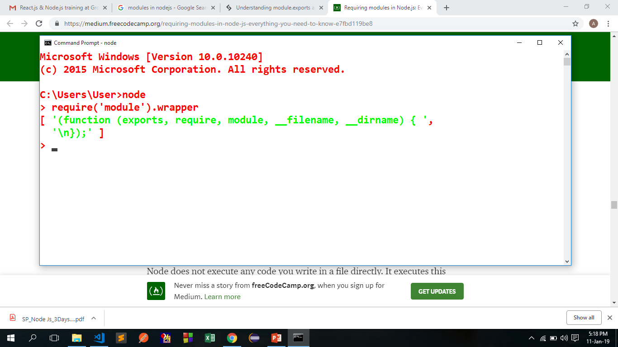
Node js – magic scope
Before compiling a module, Node wraps the module code in a function, which we can inspect using the wrapper property of the module module.

Slide 37
Node’s wrapping process.
Node does not execute any code you write in a file directly.
It executes this wrapper function which will have your code in its body.
This is what keeps the top-level variables that are defined in any module scoped to that module.
This wrapper function has 5 arguments: exports, require, module, __filename, and __dirname.
This is what makes them appear to look global when in fact they are specific to each module.

Slide 38
Node’s wrapping process.
All of these arguments get their values when Node executes the wrapper function.
exports is defined as a reference to module.exports prior to that.
require and module are both specific to the function to be executed
__filename/__dirname variables will contain the wrapped module’s absolute filename and directory path.

Slide 39
Node’s wrapping process.
since every module gets wrapped in a function, we can actually access that function’s arguments with the arguments keyword
Type the following code in a file and execute the file to see that every module is a function and has 5 parameters in its call
console.log(arguments);

Slide 40
Node’s wrapping process
The first argument is the exports object, which starts empty.
Then we have the require/module objects, both of which are instances that are associated with the index.js file that we’re executing. They are not global variables.
The last 2 arguments are the file’s path and its directory path.
The wrapping function’s return value is module.exports.
Inside the wrapped function, can use the exports object to change the properties of module.exports, but we can’t reassign exports itself because it’s just a reference.
exports.id = 42; // This is ok.
exports = { id: 42 }; // This will not work.
module.exports = { id: 42 }; // This is ok.

Slide 41
Why the following works in this manner exports = { id: 42 }; // This will not work. module.exports = { id: 42 }; // This is ok.
var obj={id:1};
var obj1=obj;
obj1.id=90;
console.log(obj);// {id:90}
obj1={id:777};
console.log(obj);//{id:90}

Slide 42
wrapping function’s return value is module.exports.
Inside the wrapped function, we can use the exports object to change the properties of module.exports, but we can’t reassign exports itself because it’s just a reference.
What happens is roughly equivalent to:
function (require, module, __filename, __dirname) {
let exports = module.exports;
// Your Code...
return module.exports;

Slide 43
Important – About exports
The keyword require returns an object, which references the value of module.exports for a given file.
If a developer unintentionally or intentionally re-assigns module.exports to a different object or different data structure, then any properties added to the original module.exports object will be unaccessible.

Slide 44
require object
There is nothing special about require.
Object that acts mainly as a function that takes a module name or path and returns the module.exports object.
Can simply override the require object with our own logic if we want to.

